Slide 1
Network Simulation using NS3

Slide 2
1
What is NS3?
Notes:
Add a small picture

Slide 3
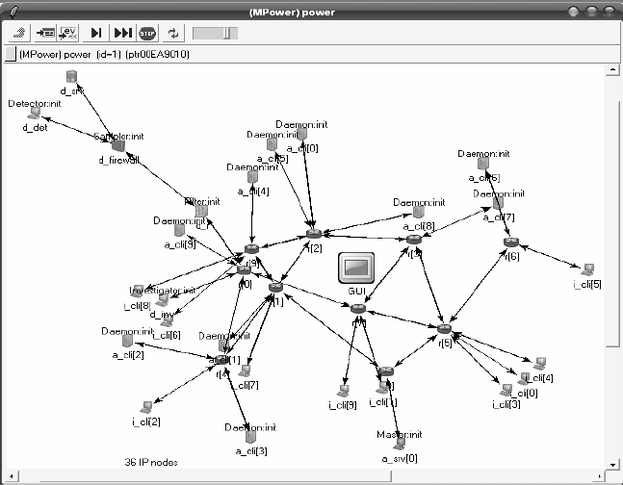
What is NS3?
Network and Network Simulation
A network consists of two or more devices connected to each and network simulation is modeling the behaviour of a computer network
NS3
NS3 is a network simulator tool used to simulate
a real world computer network on a computer.
Notes:
Explain what is a network and network simulation
Add photo?

Slide 4
About NS3
NS3
NS3 is an open source software
Programming languages: C++, Python
History
Inventors: Sally Floyd, Tom Henderson, George Riley and Sumit Roy
Before NS3 there was NS1 and NS2
Notes:
What is ns3, its purpose.
Inventors, and history (Small)

Slide 5
2
Uses and Terminology

Slide 6

Uses of NS3
Detect possible errors
Network Research and educational purposes
Ns3 can be used to simulate various network attacks.
Networks can be studied without physically damaging/modifying them.
Used in defense, software companies
Notes:
It can be used to detect possible errors or failures in a network.
Network research (studying different protocols and improving the current protocols, study how networks behave when there is too much inflow of data)
Critical situation-> networks can be studied without physically damaging/modifying them -> easy to setup, deploy and maintain

Slide 7


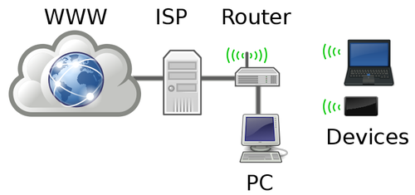


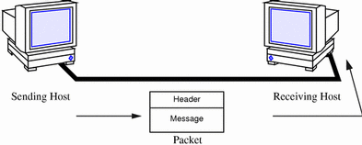
What can we simulate?
Nodes
Protocols
Transmission medium
Packets
Apps
Network Interface
cards
Notes:
Node: : Client, routers, servers….
Applications: Send and receive packets to generate traffic in network

Slide 8
Node
1
Application
2
Net-Device
Channel
NS3 Terminology
4
3
Topology Helpers
5
Container
6
Node is like a computer to which we add functionality using other classes in the NS3 Module
Application is the NS3 representation of real world apps.
A net-device is used to simulate software driver and hardware functionality of a network interface card.
Channel is the actual method used for transfer of data. For example: Ethernet, WiFi
Topology Helpers reduce the task of a programmer by doing repetitive and common tasks.
Containers are array like structures which contain multiple nodes/devices/interfaces etc.
Notes:
Ns3 terminology.
Node is represented by C++ Node class.
Application are responsible for sending and receiving data.
Channels can be point-to-point, CSMA, WiFi
NIC helps a computer connect to a network. IP addresses are assigned to these net devices.
For example, it may take many distinct ns-3 core operations to create a NetDevice, add a MAC address, install that net device on a Node, configure the node’s protocol stack, and then connect the NetDevice to a Channel. But topo h do it for us.

Slide 9
3
Demo

Slide 10
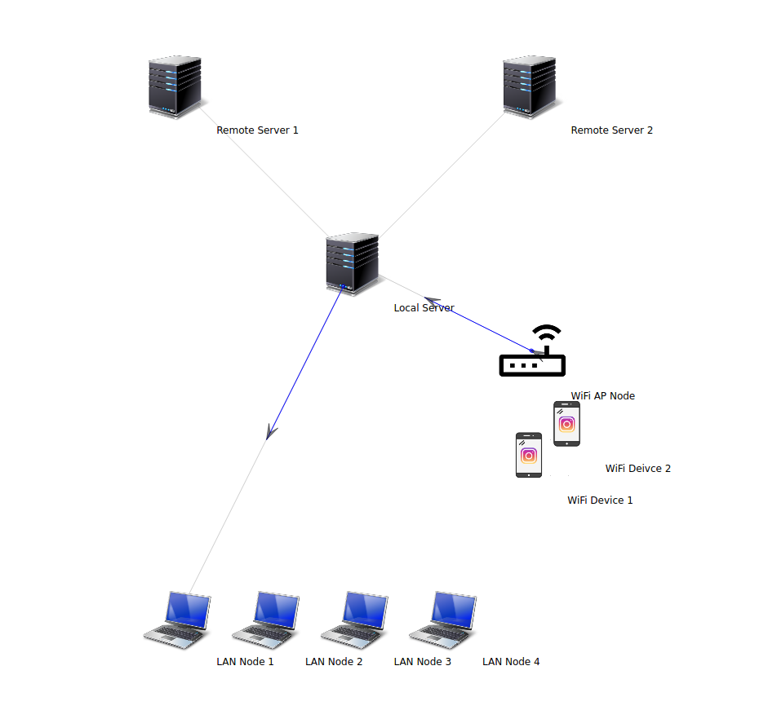
IIT GOA Network
Simulation
Notes:
Describe what in included in our network
Flow of simulation
Link of code

Slide 11
4
Advantages and Disadvantages

Slide 12
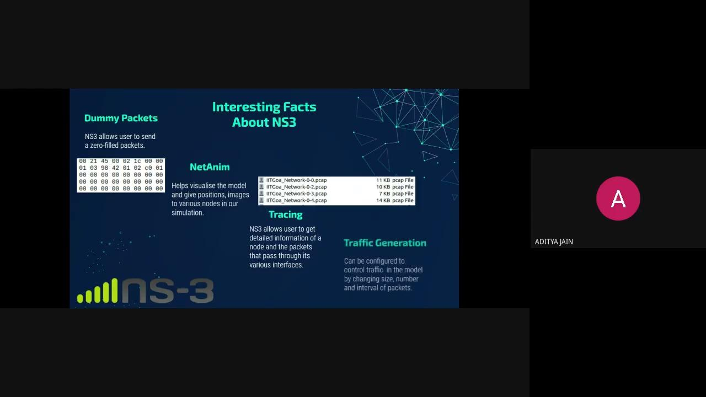

Slide 13
5
Other Alternatives

Slide 14

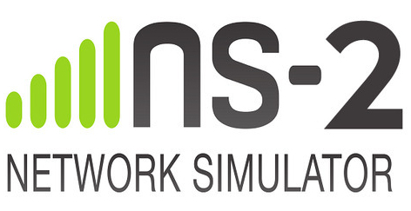



Other Alternatives
Commercial
OPNET
Open Source
NS-2
2. QualNET
2. OMNeT++
NetSim
Notes:
OPNET : OPNET Network simulator is a tool to simulate the behavior and performance of any type of network. The main difference Opnet Network Simulator comparing to other simulators lies in its power and versatility
QualNet : QualNet is a testing and simulation tool owned and provided by Scalable Network Technologies. QualNet can run on cluster, multi-core, and multi- processor systems to model large networks with high fidelity
NS2- It is an old version of Ns-3. But is still used for some researches.
OMNeT++ (Objective Modular Network Testbed in C++) .OMNeT++ itself is a simulation framework without models for network protocols like IP or HTTP
NetSim -- It is one of the most popular network simulator. It simulates a wide variety of Cisco routers.

Slide 15
6
Summary

Slide 16
Summary
NS3 is an open source network simulator tool
We can simulate nodes, applications, protocols etc
NS3 Terminology
IIT Goa network simulation
Advantages and disadvantages
Alternatives : commercial , open source
Notes:
Summary in points

Slide 17
References
Installation
→ https://www.nsnam.org/releases/ns-3-30/download/
→ https://youtu.be/tgl9Z6C3zlM
→ https://youtu.be/HRAjKRrvgh4
Reading material
→ https://www.nsnam.org/
→ https://www.nsnam.org/tutorials
→ https://www.nsnam.org/tutorials/ns-3-tutorial-Walid-Younes.pdf
→ https://www.nsnam.org/tutorials/NS-3-LABMEETING-1.pdf
→ https://www.nsnam.org/doxygen/index.html
Notes:
References or Relevant materials

Slide 18
Questions??

Slide 19
Thank You!
Aditya Jain - 1903102
Adwait Agashe - 1903103
Gunjan Mayekar - 1903117
Jay Chawrey - 1904111

